Slide 1
FOSS

Slide 2
What is FREE SOFTWARE
Free software is software that users are free to use, modify, and distribute without any restrictions on access or use. The term "free" in this context refers to freedom, not price. Free software is often distributed under a license that ensures that the software remains free, even when modified or redistributed.

Slide 3
Free software has several characteristics, including:
Freedom to use: Free software provides users with the freedom to run, install, and use the software for any purpose, without any restrictions.
Freedom to modify: Free software allows users to modify and customize the software to meet their specific needs and requirements, providing greater flexibility and control over software functionality.
Freedom to distribute: Free software can be distributed freely, without any restrictions on the number of copies or recipients.
Source code availability: Free software provides access to the source code, which can be modified and redistributed, allowing for greater transparency and community-driven development.

Slide 4
Examples of FREE SOFTWARE
Linux Operating System: Linux(Lovable Intellect Not Using XP) is a free and open source operating system that is widely used in enterprise environments and personal computers.
Apache Web Server: Apache is a free and open source web server that is used to serve web pages on the internet.
LibreOffice: LibreOffice is a free and open source office productivity suite that includes word processing, spreadsheet, and presentation software.
GIMP: GIMP (GNU Image Manipulation Program)is a free and open source image editing software that can be used for tasks such as photo retouching, image composition, and image authoring.

Slide 5
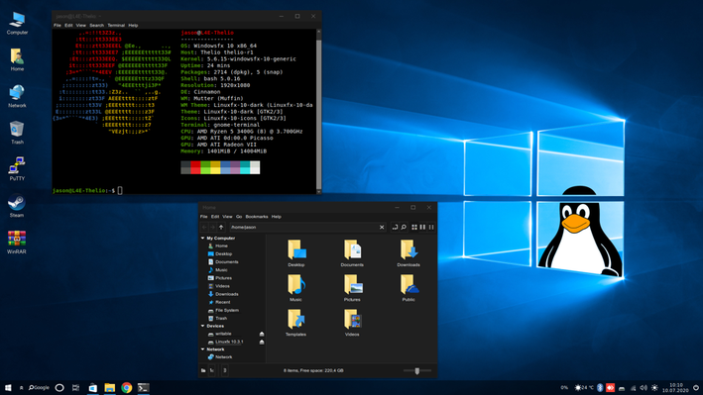
LINUX

Slide 6
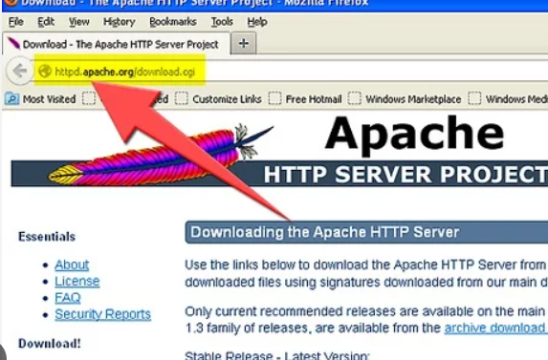
APACHE WEB SERVER

Slide 7
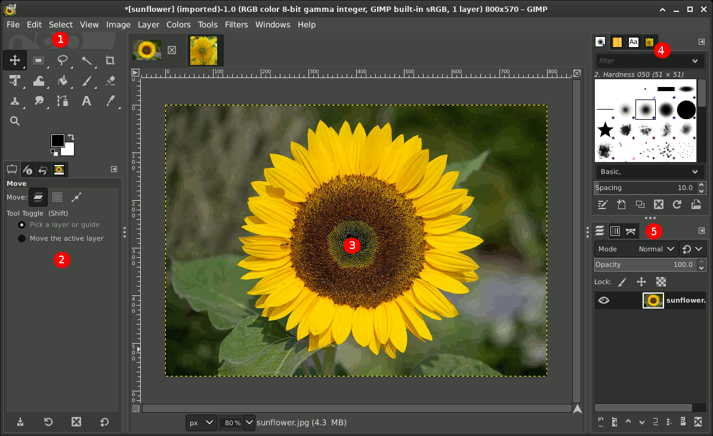
GIMP

Slide 8
Examples of FREE SOFTWARE
VLC Media Player: VLC is a free and open source multimedia player that supports a wide variety of audio and video formats.
Firefox Web Browser: Firefox is a free and open source web browser that is developed by the Mozilla Foundation
MySQL: MySQL is a free and open source relational database management system that is widely used in web applications
Blender: Blender is a free and open source 3D computer graphics software that can be used for creating animations, visual effects, and video games.

Slide 9
1. What is a key reason for the need for Open Source Software?
a) It is always more secure than proprietary software
b) It is free of cost
c) It promotes innovation and collaboration

Slide 10
1. What is a key reason for the need for Open Source Software?
a) It is always more secure than proprietary software
b) It is free of cost
c) It promotes innovation and collaboration

Slide 11
2. Which of the following is a benefit of Open Source Software for businesses?
a) It requires a large upfront investment
b) It is always more stable than proprietary software
c) It allows businesses to customize and modify software to fit their needs

Slide 12
2. Which of the following is a benefit of Open Source Software for businesses?
a) It requires a large upfront investment
b) It is always more stable than proprietary software
c) It allows businesses to customize and modify software to fit their needs

Slide 13
3. What is the main principle of Free Software?
It must be distributed at some cost to the user
It must be available with the source code and under a license that allows for modification and redistribution
It must be approved by a governing body before it can be used

Slide 14
b) It must be available with the source code and under a license that allows for modification and redistribution
The main principle of Free Software is that users have the freedom to run, study, modify, and distribute the software. This is typically facilitated through open-source licenses that grant these rights to users, ensuring that the software remains accessible and customizable. The term "free" in this context refers to freedom, not necessarily price.

Slide 15
4. What is a benefit of using Free Software?
It is always more expensive than proprietary software
It provides greater control and freedom to users
It is always more secure than proprietary software

Slide 16
5. What is a benefit of Open Source Software for government organizations?
a) It is always more secure than proprietary software
b) It is more expensive than proprietary software
c) It promotes transparency and accountability in government operations

Slide 17
5. What is a benefit of Open Source Software for government organizations?
a) It is always more secure than proprietary software
b) It is more expensive than proprietary software
c) It promotes transparency and accountability in government operations
Open source software allows governments to inspect, modify, and distribute the software, which can help ensure transparency in how public services are delivered. It also provides opportunities for public collaboration and feedback, fostering accountability in the system.

Slide 18
6. What is a benefit of Open Source Software for developers?
a) It is always easier to use than proprietary software
b) It promotes collaboration and allows for learning from others' code
c) It provides job security for developers

Slide 19
6. What is a benefit of Open Source Software for developers?
a) It is always easier to use than proprietary software
b) It promotes collaboration and allows for learning from others' code
c) It provides job security for developers

Slide 20
7. What is the potential impact of Open Source Software on education?
a) It can make education more expensive
b) It can make education more accessible and affordable
c) It can reduce the quality of education

Slide 21
7. What is the potential impact of Open Source Software on education?
a) It can make education more expensive
b) It can make education more accessible and affordable
c) It can reduce the quality of education

Slide 22
8. What is the potential impact of Open Source Software on healthcare?
a) It can increase healthcare costs
b) It can improve patient outcomes through better software tools
c) It can make healthcare less accessible

Slide 23
8. What is the potential impact of Open Source Software on healthcare?
a) It can increase healthcare costs
b) It can improve patient outcomes through better software tools
c) It can make healthcare less accessible

Slide 24
9. What is the potential impact of Open Source Software on scientific research?
a) It can increase collaboration and accelerate scientific progress
b) It can hinder scientific progress by making it difficult to protect intellectual property
c) It has no impact on scientific research

Slide 25
9. What is the potential impact of Open Source Software on scientific research?
a) It can increase collaboration and accelerate scientific progress
b) It can hinder scientific progress by making it difficult to protect intellectual property
c) It has no impact on scientific research

Slide 26
10. Which of the following is an example of Open Source Software that had a significant impact on the world?
a) Microsoft Office
b) Google Chrome
c) Linux

Slide 27
10. Which of the following is an example of Open Source Software that had a significant impact on the world?
a) Microsoft Office
b) Google Chrome
c) Linux

Slide 28
11. What is the impact of Open Source Software on software development as a whole?
a) It has made proprietary software obsolete
b) It has led to more collaboration and innovation in software development
c) It has made software development less accessible

Slide 29
11. What is the impact of Open Source Software on software development as a whole?
a) It has made proprietary software obsolete
b) It has led to more collaboration and innovation in software development
c) It has made software development less accessible

